Slide 1



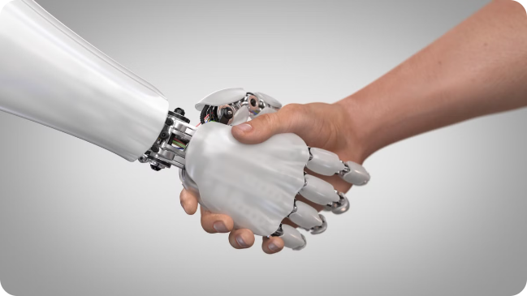
The Impact of AI on Employment
Name:-Krishna Patel
Enrollment No. :-21002170110108
Branch:-CE
Roll No. :-43

Slide 2

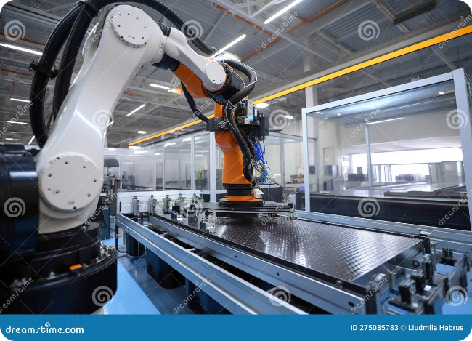
Introduction
AI is the ability of computer systems to perform tasks typically requiring human intelligence, such as learning, problem-solving, and decision-making.
1
Rapid Advancement
2
Everyday Applications
AI technologies are advancing at an unprecedented rate, leading to significant transformations across various industries.
AI is being implemented in numerous applications, from self-driving cars to medical diagnosis.
3
Impact on Workforce
The rise of AI raises critical questions about its impact on the future of work and the skills needed for success in the evolving job market.

Slide 3
Positive Impacts of AI on Employability
AI can create new job opportunities and enhance existing roles by leveraging its capabilities to augment human capabilities.
Job Creation
Upskilling and Reskilling
Enhanced Productivity
The development, deployment, and maintenance of AI systems will generate new job roles in fields such as data science, AI engineering, and AI ethics.
AI can facilitate upskilling and reskilling programs, equipping workers with the skills needed to adapt to the changing job market.
AI can assist workers by automating tasks, freeing up time for higher-value activities and leading to increased productivity and efficiency.

Slide 4


Negative Impacts of AI on Employability
While AI offers numerous benefits, it also poses potential challenges to the workforce, including job displacement and skills gaps.
Job Displacement
AI can automate tasks previously performed by humans, leading to job losses in certain sectors.
Skills Gap
The rapid pace of AI development creates a skills gap, as workers may lack the technical expertise required for new AI-related roles.
Income Inequality
AI-driven automation could exacerbate income inequality, as workers in certain sectors may be displaced or see their wages decline.

Slide 5






AI Adoption in India
India is witnessing a rapid adoption of AI across various sectors, with significant implications for the workforce.
Government Initiatives
Growing Startup Ecosystem
The Indian government has launched several initiatives to promote AI adoption and foster innovation in the field.
India has a thriving startup ecosystem, with many companies developing AI-powered solutions for various industries.
Data Availability
Educational Programs
India's vast population and digitalization efforts have created a wealth of data, which is essential for AI development and training.
Educational institutions are increasingly offering AI-related courses and programs to meet the growing demand for AI skills.

Slide 6


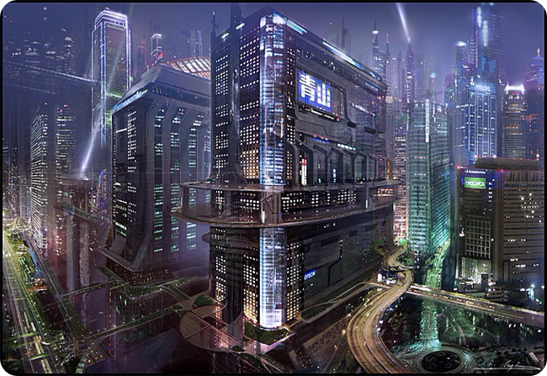


New Job Roles and Industries
AI is creating new job roles and industries, driven by the demand for AI expertise and the application of AI in various sectors.
AI Engineers
Professionals who design, build, and maintain AI systems.
Data Scientists
Experts who analyze large datasets to extract insights and develop AI models.
AI Ethics Specialists
Professionals who ensure that AI systems are developed and used ethically and responsibly.

Slide 7


Transformation of Existing Job Roles
AI is transforming existing job roles by augmenting human capabilities and automating tasks, leading to a shift in skill requirements.
Healthcare
Finance
AI is being used to assist doctors in diagnosis, treatment planning, and patient monitoring, leading to more efficient and personalized healthcare.
AI is used for fraud detection, risk assessment, and personalized financial advice, enhancing efficiency and accuracy in the financial sector.
Manufacturing
AI is used for automation, quality control, and predictive maintenance, leading to improved efficiency and productivity in manufacturing processes.

Slide 8

AI in Agriculture: Precision Farming and Yield Optimization
1
Precision Farming
2
Yield Optimization
AI-powered sensors and drones collect data about soil, weather, and crops, allowing farmers to optimize irrigation, fertilization, and pest control.
AI algorithms can analyze data to predict crop yields, identify areas for improvement, and recommend best practices for maximizing production.
3
Resource Management
4
Labor Optimization
AI helps optimize the use of water, fertilizer, and pesticides, promoting sustainability and reducing environmental impact.
AI-powered robots and autonomous systems can automate tasks like planting, harvesting, and weeding, reducing labor needs and increasing efficiency.

Slide 9


AI in the Banking and Finance Sector: Fraud Detection and Risk Management
1
Fraud Detection
AI algorithms analyze transaction patterns and identify suspicious activities, helping prevent fraud and protect customers.
2
Risk Assessment
AI systems can assess the creditworthiness of borrowers, evaluate loan applications, and identify potential risks associated with investments.
3
Personalized Financial Services
AI-powered chatbots and virtual assistants provide personalized financial advice, helping customers manage their finances effectively.

Slide 10





AI in the Retail Sector: Personalized Recommendations and Inventory Management
Personalized Recommendations
AI algorithms analyze customer purchase history and preferences to offer personalized product recommendations, improving customer satisfaction and increasing sales.
Inventory Optimization
AI systems can predict demand, optimize stock levels, and automate inventory management, reducing waste and minimizing stockouts.
Customer Service Automation
AI-powered chatbots and virtual assistants provide quick and efficient customer support, resolving queries and addressing issues promptly.

Slide 11


AI in the Healthcare Sector: Diagnosis and Treatment Optimization
Medical Imaging Analysis
AI algorithms can analyze medical images to assist in disease diagnosis and identify potential abnormalities, improving accuracy and speed.
Drug Discovery and Development
AI accelerates drug discovery by identifying promising candidates and optimizing drug formulations.
Personalized Medicine
AI systems can analyze patient data to tailor treatment plans and therapies, maximizing effectiveness and minimizing side effects.

Slide 12


Case Studies: Successful AI Integration Across Industries
Amazon Robotics
Babylon Health
Amazon's use of AI-powered robots in warehouses has significantly improved efficiency and reduced costs.
Babylon Health leverages AI to provide remote medical consultations, offering convenient and affordable healthcare access.

Slide 13


Public Perception of AI
1
Fear of Job Displacement
2
Excitement about Innovation
Many people are concerned about the potential for AI to automate jobs, leading to widespread unemployment.
Others are excited about the potential for AI to solve complex problems and improve our lives in various ways.
3
Ethical Concerns
4
Hope for a Better Future
There are concerns about the ethical implications of AI, such as bias in algorithms and the potential for misuse.
Some people believe that AI can be a force for good, leading to a more equitable and prosperous society.

Slide 14





Challenges in AI Adoption
Data Requirements
AI models require massive amounts of data for training and development, which can be expensive and difficult to acquire.
Lack of Expertise
There is a shortage of skilled AI professionals, making it challenging for organizations to implement AI effectively.
Ethical Considerations
Organizations need to carefully consider the ethical implications of using AI, such as bias and privacy concerns.

Slide 15


Conclusion
AI is a transformative technology with the potential to revolutionize many aspects of our lives, from healthcare to transportation. It's important to address the challenges of AI adoption while harnessing its power for a better future.

